Slide 1
Renewable Electricity Growth:
Regression, Forecasting, and Transition Analysis
Jake Schwartz and Daniel Wood
Notes:
Slide 1 — Title
This project looks at how renewable electricity has grown across countries over time, and it combines two goals: explaining what has already driven that growth and building toward forecasting where renewable generation may go next.
Our focus is global rather than country-specific, so instead of telling one national story, we are trying to identify broad patterns that show up across many energy markets and over multiple decades.
At a high level, this presentation walks through the data source, the cleaning and integration process, the exploratory patterns we found, the regression framework we built, and the main limitations that shape our next steps.

Slide 2


Project Overview
Current Objective
Explain renewable electricity growth with panel regressions, then extend the project with forecasting, clustering, decomposition, and lagged-capacity analysis.
Methods Now Completed
Core Data
Data merging and cleaning.
Exploratory analysis and fixed-effects regression.
ARIMA forecasting, K-means clustering, renewable-share decomposition, and lagged models.
17 renewable-energy source files merged into analytic panels.
Broad panel for cross-country patterns and a smaller capacity panel for deeper modeling.
Notes:
Slide 2 — Project Overview
The primary objective of the project is to explain and predict renewable electricity growth from 1965 to the present, so we are treating this as both an explanatory data problem and a predictive modeling problem.
Methodologically, we split the work into two parts: panel regression to identify likely drivers of growth across countries and time, and time-series forecasting to eventually project future renewable electricity trends.
The dataset comes from 17 merged CSV files sourced through Kaggle, which gives us broad coverage across electricity generation, installed capacity, and renewable market-share variables rather than relying on a single narrow measure.

Slide 3

Data Preparation and Scope
Processing Pipeline
Merged 17 source CSVs, standardized variable names, checked country overlap, and removed aggregate regions from the modeling stage to keep the panel country-based.
Broad Panel
Capacity Panel
Regression Sample
251
12
9
Entities with renewable generation and electricity-share measures.
Entities with installed wind and solar capacity before filtering.
Countries used in fixed-effects, lagged-capacity, and forecasting extensions.
Notes:
Data Preparation (Complete)
After identifying those inconsistencies, we built a processing pipeline that merged all 17 CSVs, standardized column names, handled missing values, and removed regional aggregates so the final structure was more analytically reliable.
The merged result gives us broad global coverage, with 251 countries for generation and electricity-share metrics, while capacity data is available for a much smaller subset of key markets and only a few countries are fully complete across all variables.
That tradeoff is central to the project: we have wide coverage for descriptive analysis, but much narrower coverage for high-fidelity modeling once we require complete observations across multiple capacity and generation measures.

Slide 4
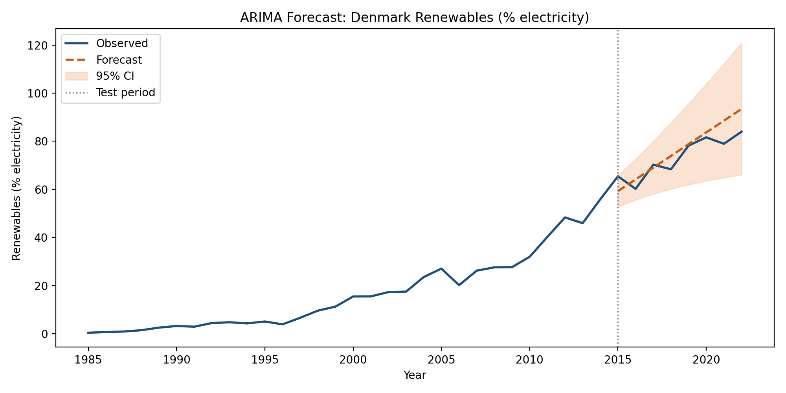
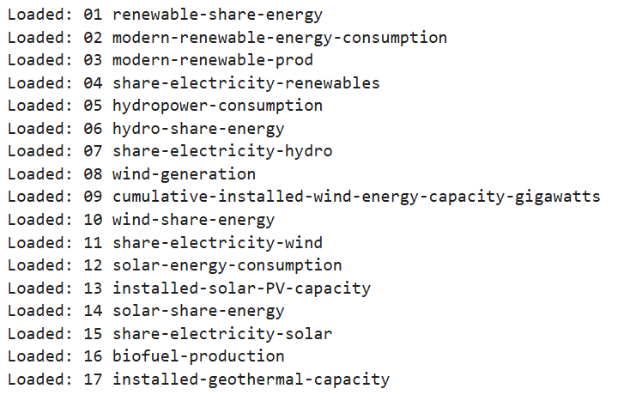
ARIMA Forecasting
Forecasting Result
ARIMA forecasting is now implemented for renewable electricity share. For Denmark, the selected model was ARIMA(0,2,2) with an 8-year holdout and MAPE of about 6.57%.
Notes:
So we’re dealing with quite a few tables and .csv files, so the first thing we have to figure out, since the variables of interest are in different files, is how to merge them.

Slide 5
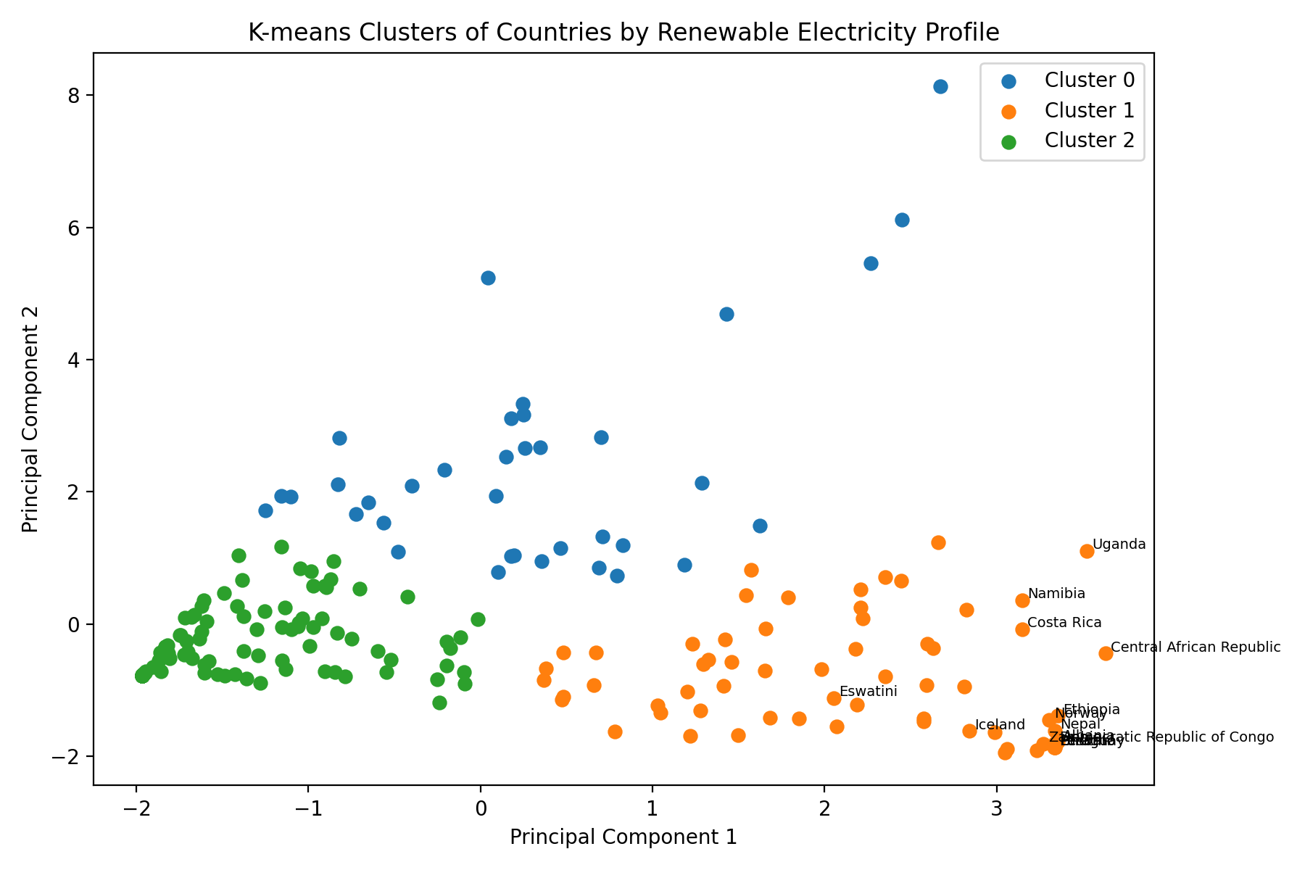
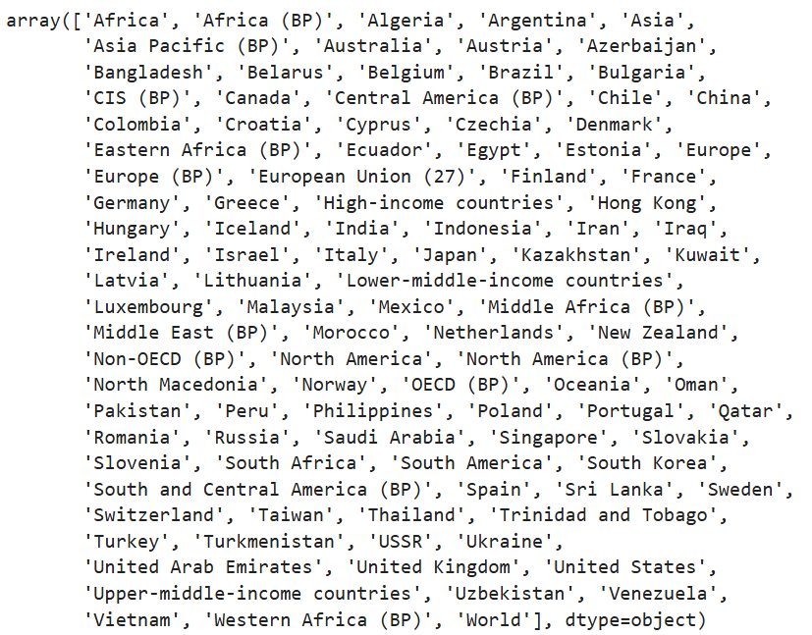
K-means Country Clusters
Notes:
It’s when looking at the countries within the first file that I can start to figure out what the main problem to merging our data will be.

Slide 6
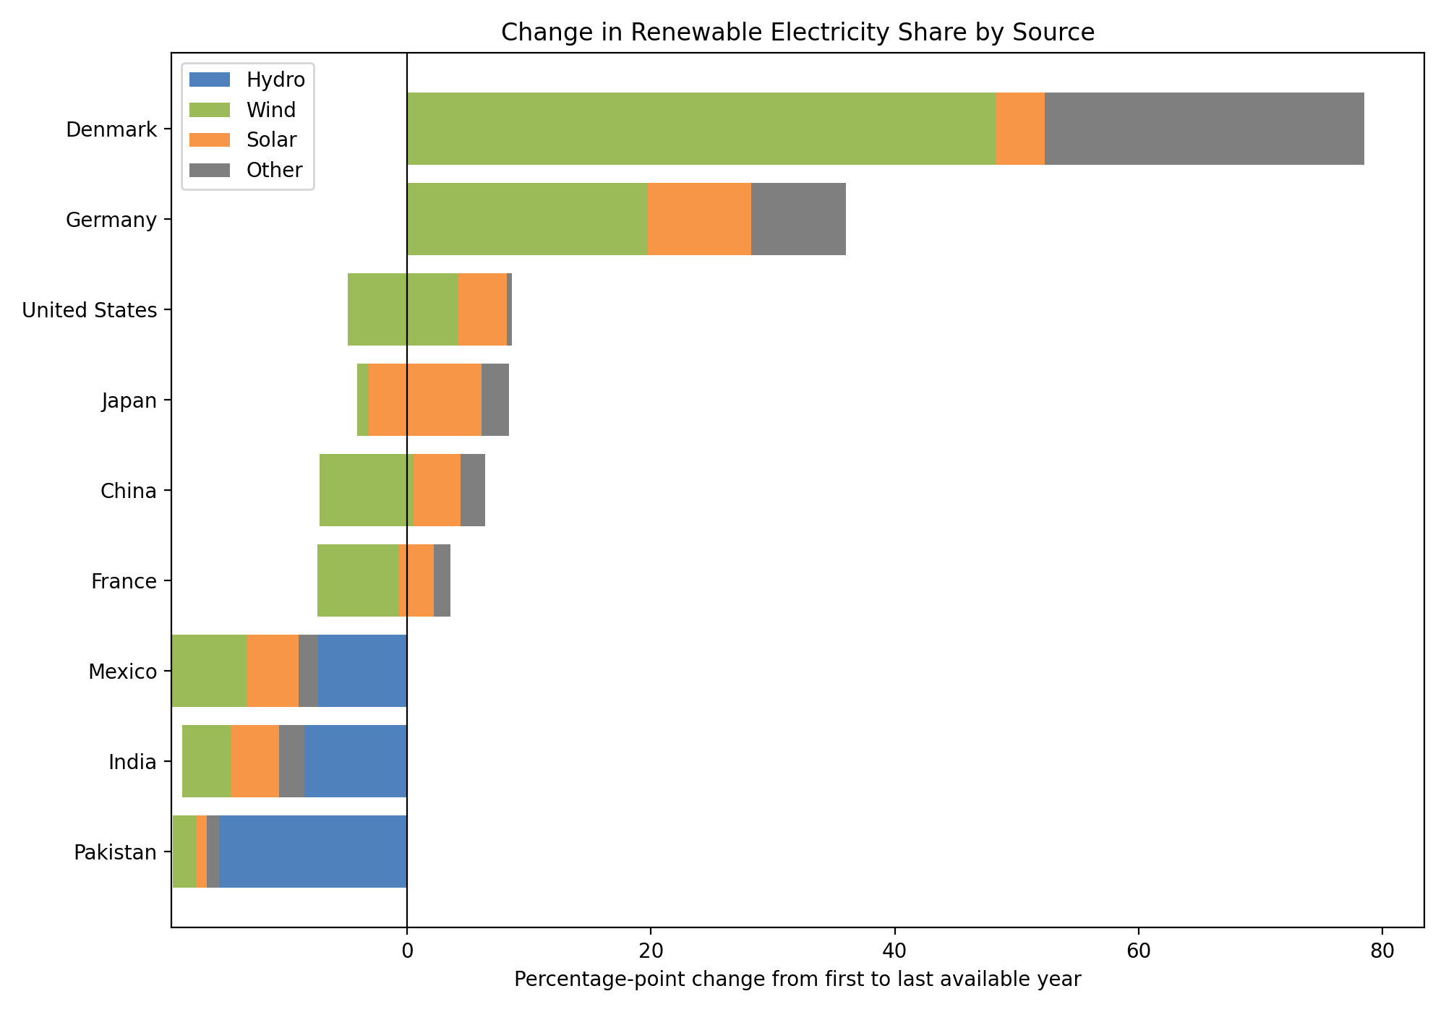
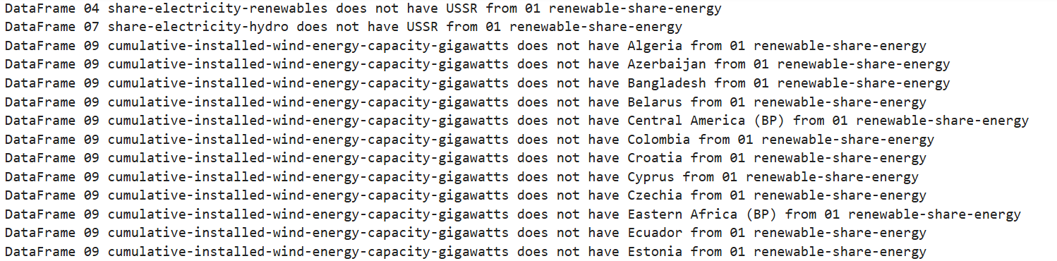
Renewable Share Decomposition

Slide 7
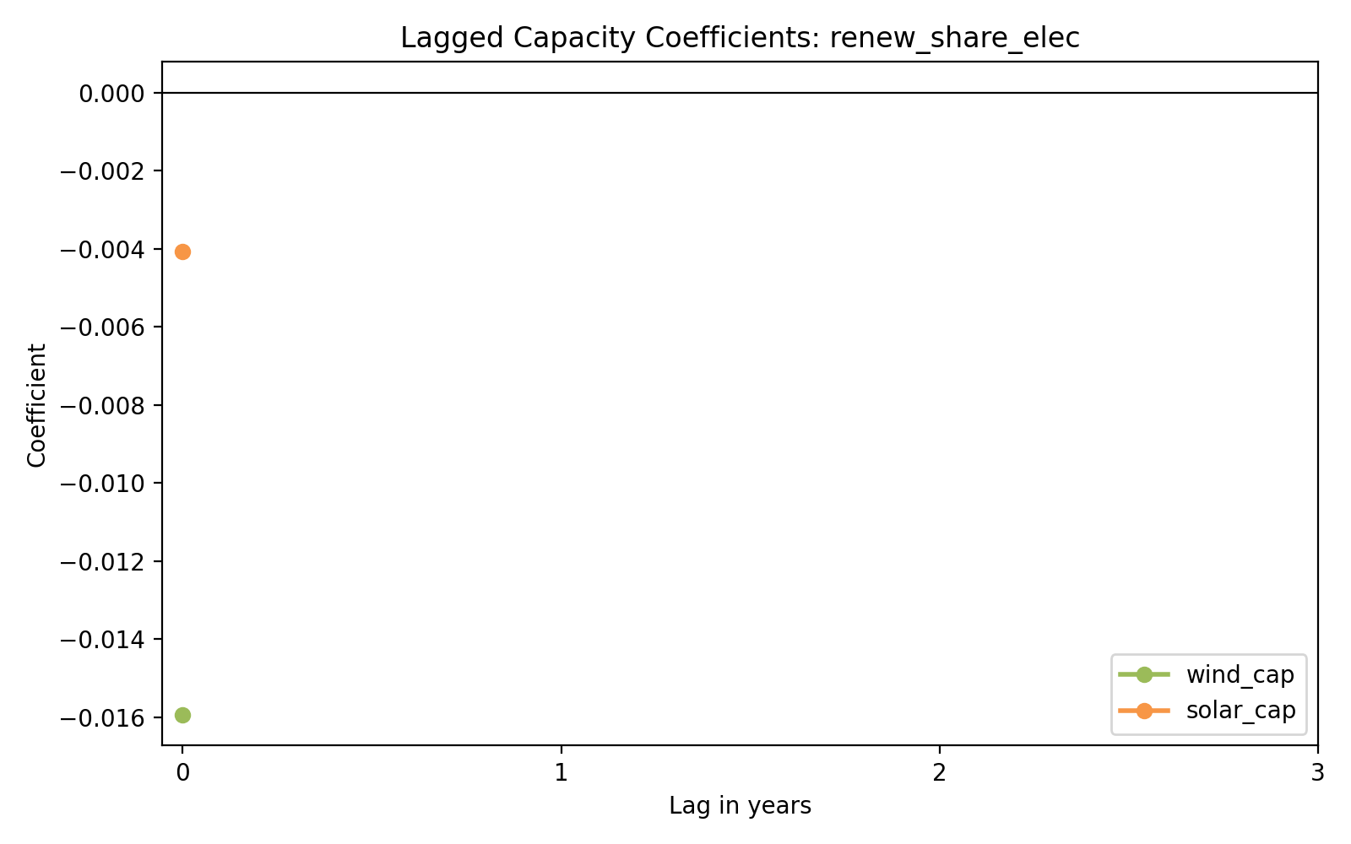
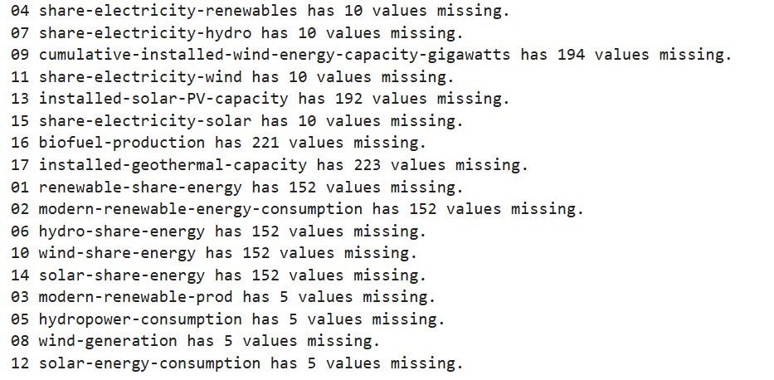
Lagged Capacity and Renewable Share

Slide 8

What EDA and Regression Already Showed
Exploratory Patterns
Wind generally appears earlier in the sample.
Solar accelerates later, especially after about 2008.
China and the United States dominate absolute scale, which motivated fixed effects.
Baseline Regression Results
Wind generation rises by about 1.96 TWh per added GW of wind capacity.
Solar generation rises by about 1.06 TWh per added GW of solar capacity.
Both models fit very strongly with R-squared around 0.97.
Interpretation
Capacity clearly predicts later generation, but the joint renewable-share model remains weaker.
That is why the new extensions focus on timing, country profiles, and source decomposition.
Notes:
Slide 9 — Exploratory Analysis (Interpretation)
Here we summarize the logic of the exploratory phase: we used country-level time-series plots and pooled scatter plots to understand both temporal patterns and the cross-sectional relationship between capacity and generation.
The geospatial story is that China and the United States dominate in absolute levels, so any model using raw values has to account for country-specific scale differences rather than assuming all countries are directly comparable.
We also see a timing pattern where wind expansion begins earlier and solar takes off more strongly around 2008, which suggests the renewable transition is technology-specific and unfolds differently across countries and periods.

Slide 9
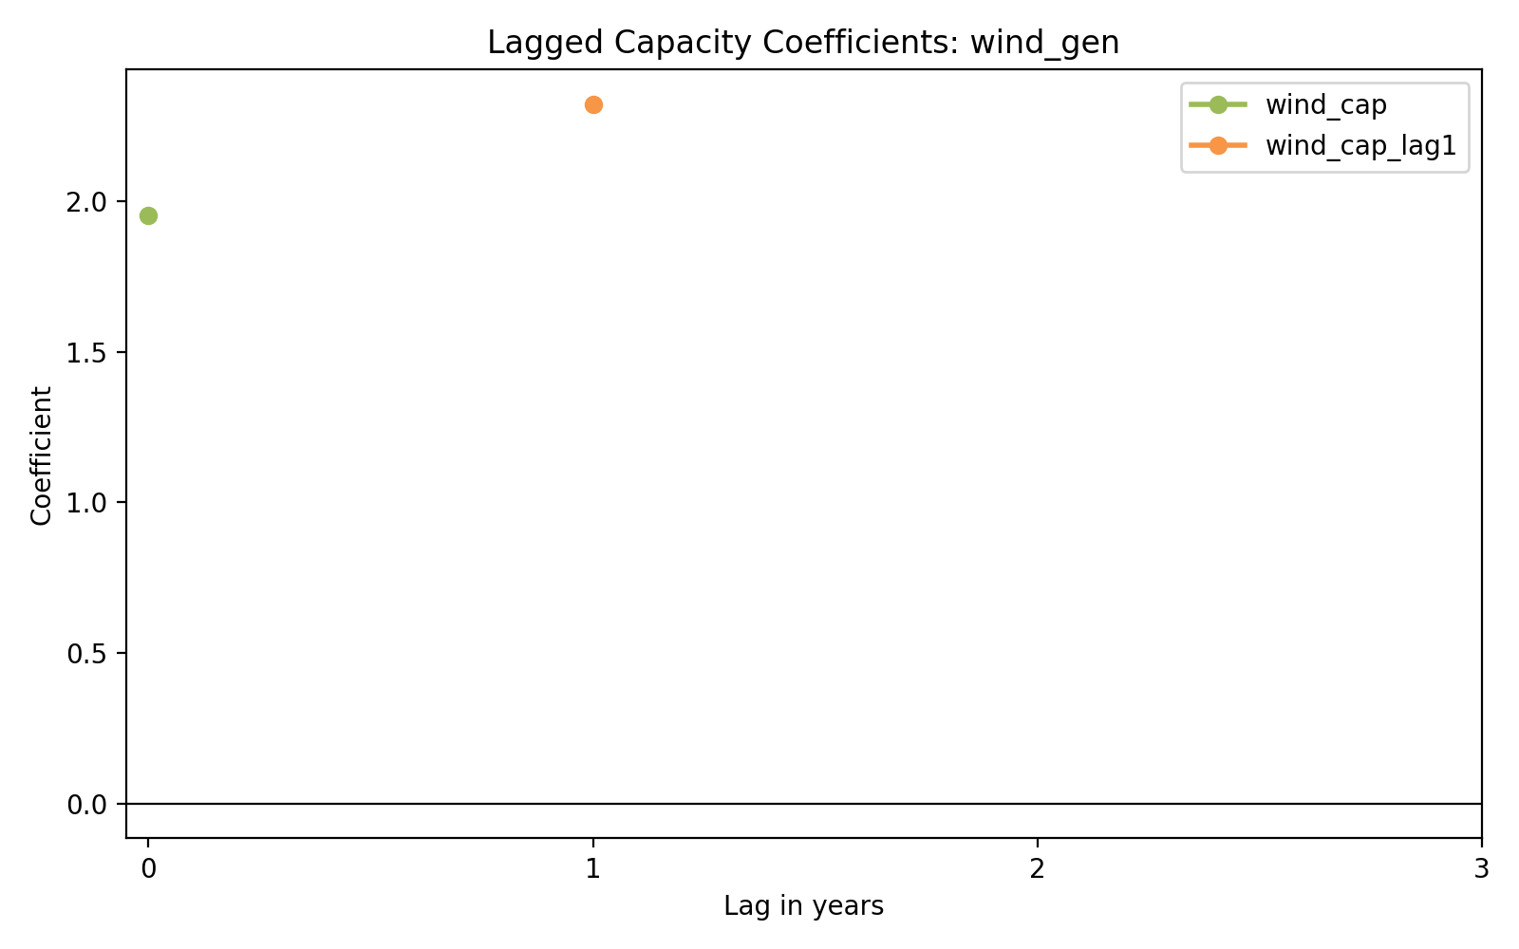
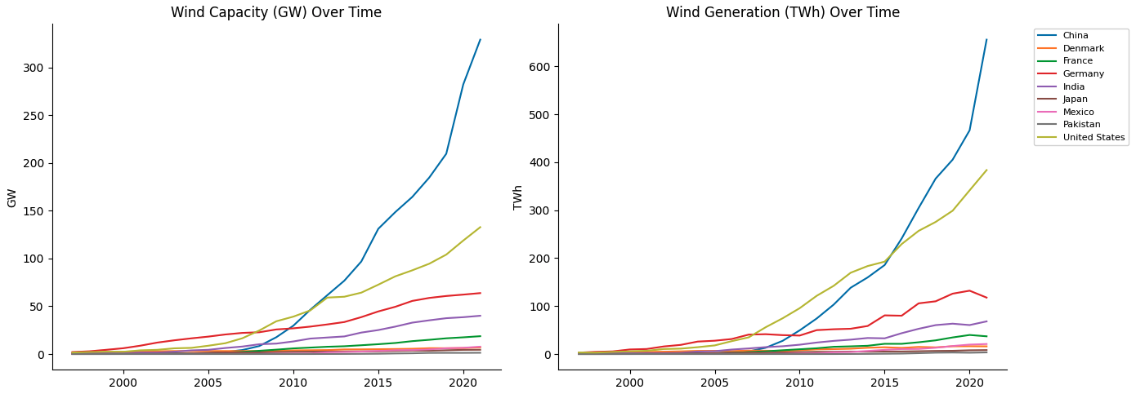
Lagged Wind Generation Effects
Notes:
Slide 8 — Exploratory Analysis (Time-Series Plots)
These plots show that wind capacity and wind generation both rise sharply over time, but the growth paths are very uneven across countries, which suggests there is substantial heterogeneity that a simple pooled model would miss.
China and the United States stand out as especially large-scale cases, with China showing the steepest acceleration in both installed capacity and generation in the later years of the sample.
The broader takeaway from this slide is that renewable expansion is not linear, not synchronized across countries, and not evenly distributed, which supports using country and year fixed effects in the regression stage.

Slide 10
Updated Model Results
Forecasting and Clustering
ARIMA forecasting is now implemented, with Denmark's holdout MAPE near 6.57%.
K-means now identifies three country profiles: hydro-dominant, fast-transition, and low-renewables clusters.
Decomposition and Lags
Wind explains most of Denmark and Germany's renewable-share increase, while Japan looks more solar-driven.
Lagged generation models strengthen the timing story, but the joint share model is still weak.
Notes:
Slide 11 — Regression Models (Specifications)
The first regression asks a straightforward explanatory question: does installed capacity predict electricity generation, separately for wind and solar, once we control for country fixed effects and year fixed effects?
The second regression moves one step higher conceptually by asking whether wind and solar capacity shift the overall energy mix, using the renewable share of electricity as the outcome rather than raw generation alone.
Together, these two models let us distinguish between technology-specific output effects and broader system-level transition effects, which is useful because a country can expand generation in one area without necessarily transforming its total electricity mix at the same pace.

Slide 11
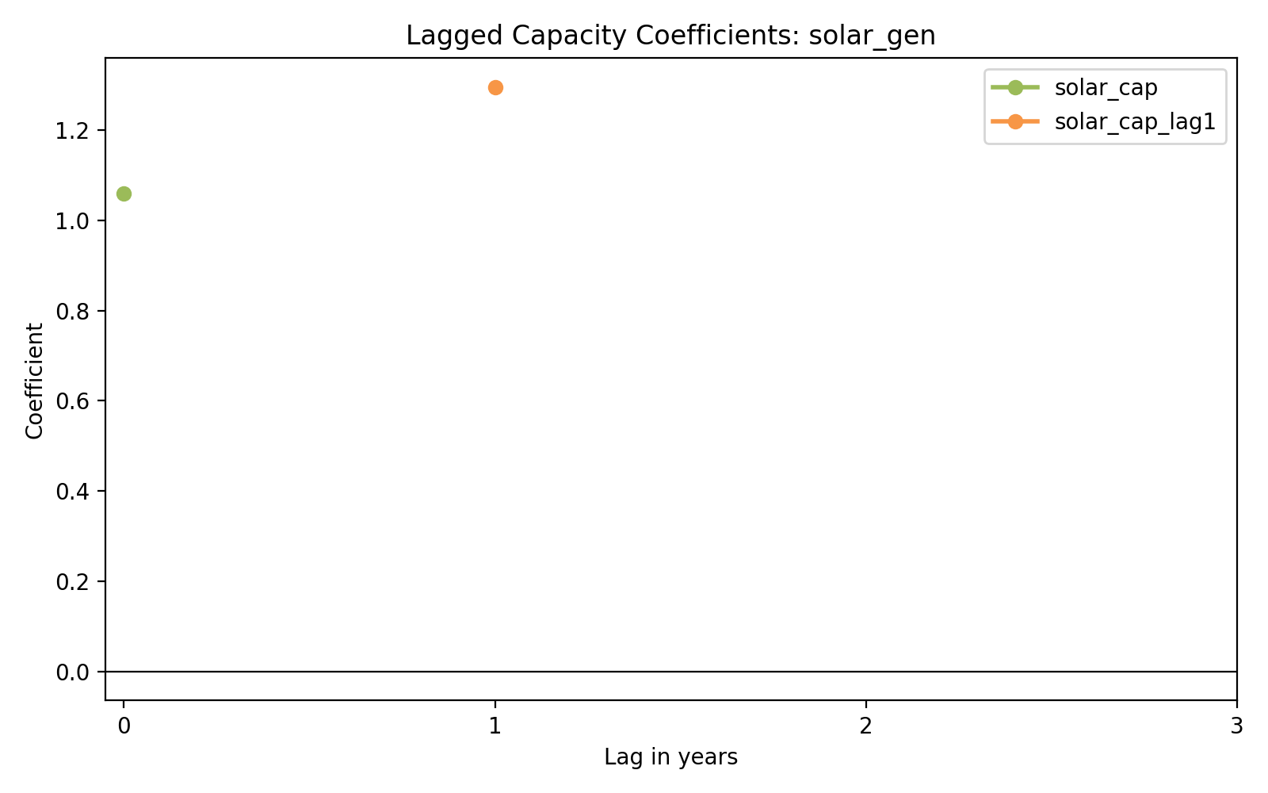
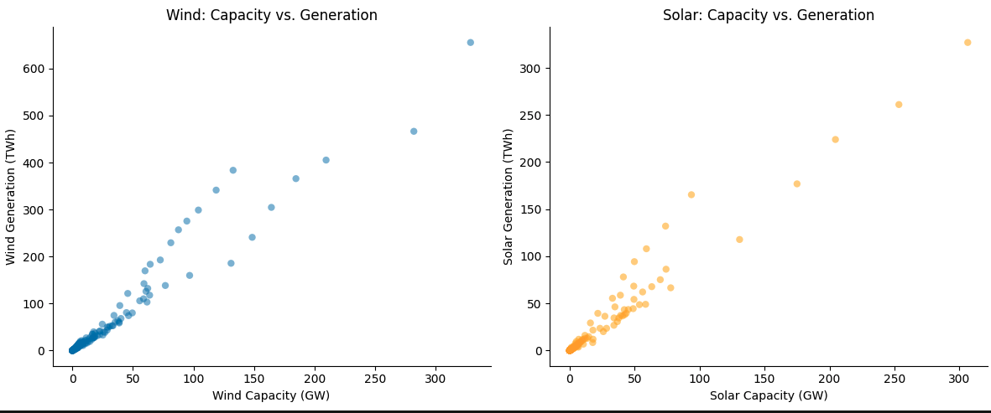
Lagged Solar Generation Effects
Notes:
Slide 10 — Regression Models (Scatter Plots)
These scatter plots show a strong positive relationship between installed capacity and electricity generation for both wind and solar, which provides a first visual justification for the regression models that follow.
At the same time, the relationship is not perfectly uniform, because countries with similar capacity levels can still produce different amounts of electricity depending on utilization, policy environment, grid integration, and local resource conditions.
So the message of this slide is that capacity is clearly informative, but it is not the whole story, which is why the formal models add country fixed effects and year fixed effects rather than relying on a simple bivariate fit.

Slide 12
Challenges
Data Constraints
The deepest modeling still depends on only 9 countries with overlapping capacity data, so generalizability remains limited.
Interpretation Limits
Lagged models improve the timing story, but they still show associations rather than a fully identified causal effect.
Modeling Gaps
Forecasting is implemented for one renewable-share series, but broader validation across countries and targets is still needed.
Notes:
Slide 12 — Challenges
The first major challenge is data scope: capacity variables are available for only a limited set of countries, so even though the overall project is global, the regression sample is much narrower than the descriptive sample.
The second challenge is methodological, because capacity and generation are mechanically related, so a strong coefficient in the first regression does not automatically imply a deep causal result; it may partly reflect built-in physical linkage.
The third challenge is temporal structure: generation may respond with a lag after capacity is installed, and since lagged variables and the forecasting component are not yet implemented, the current models should be interpreted as an early analytical baseline rather than a finished causal framework.

Slide 13
Next Steps
Expand forecasting
Run ARIMA across more countries and compare against simple baseline forecasts.
Strengthen identification
Add better controls or external policy variables if we want a stronger causal interpretation.
Refine transition story
Use decomposition and clustering together to classify hydro-led, wind-led, and solar-led transition paths.
Finalize presentation
Select the clearest visuals and turn the current outputs into a concise final narrative.
Notes:
Slide 13 — Next Steps
The immediate next step is to refine and finalize interpretation of the current regression results so we can separate robust findings from patterns that may just reflect sample structure or measurement overlap.
After that, we want to improve the causal design by adding one- to three-year lagged capacity measures, because energy infrastructure does not necessarily translate into full generation impact in the same year it is installed.
Finally, we will extend the project into formal forecasting and validation by building time-series models, testing the hydro-dominance to wind-and-solar transition hypothesis across different markets, and evaluating predictive accuracy with out-of-sample checks.
K means clustering on different countries to discern which have similar energy profiles
ARIMA Forecasting to see how accurately we can predict future generation
Random forest to discover what predicts renewable electricity share

